Slide 1
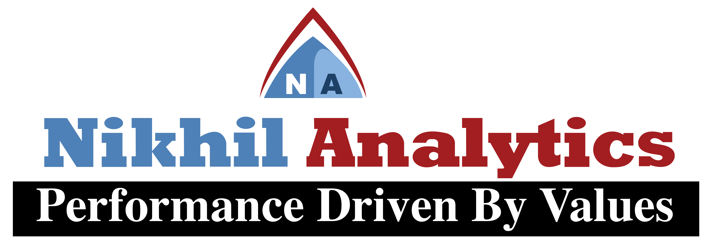
Session 1
By
Alok Ranjan
Nikhil analytics

Slide 2
Agenda of Session 1
Introduction
Basic of programming and file handling
Data Types in Python and their usages
List in Python
Decision Making Statement in Python
User defined function

Slide 3

INTRODUCTION
Python is a general-purpose interpreted, interactive, object-oriented, and high-level programming language.
It was created by Guido van Rossumduring 1985-1990.
Like Perl, Python source code is also available under the GNU General Public License GPL.
Python is designed to be highly readable. It uses English keywords frequently where as other languages use punctuation, and it has fewer syntactical constructions than other languages.

Slide 4
Python is …
Interpreter: Python is processed at runtime by the interpreter. You do not need to compile your program before executing it. This is similar to PERL and PHP.
Interactive: You can actually sit at a Python prompt and interact with the interpreter directly to write your programs.
Object-Oriented: Python supports Object-Oriented style or technique of programming that encapsulates code within objects.
Beginner’s Language: Python is a great language for the beginner-level programmers and supports the development of a wide range of applications from simple text processing to WWW browsers to games.

Slide 5
Python Features
Easy-to-learn
Easy-to-read
Easy-to-maintain
A broad standard library
Interactive Mode
Extendable
Databases
GUI Programming
Scalable
Portable

Slide 6
Basic of programming and file handling
There are three different ways to start Python:
Interactive Interpreter
Script from the Command-line
Integrated Development Environment (IDLE)

Slide 7
Interactive Mode Programming
Invoking the interpreter without passing a script file as a parameter. Type the following text at the Python prompt and press the Enter:
>>>print ("Hello, Python!")

Slide 8
Script Mode Programming
Invoking the interpreter with a script parameter begins execution of the script and continues until the script is finished. When the script is finished, the interpreter is no longer active. Let us write a simple Python program in a script. Pythonfileshaveextension.py. Type the following source code in a test.py file:
Print "Hello, Python!"
We assume that you have Python interpreter set in PATH variable. Now, try to run this program as follows –
C:/python34>python test.py

Slide 9
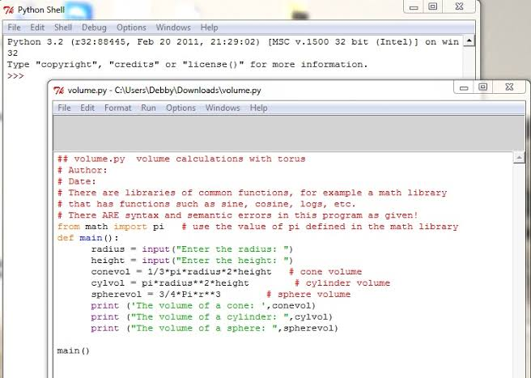
Integrated Development Environment (IDLE):
Across-platform Python development environment
IDLE helps you program in Python by:
color-coding your program code
debugging
auto-indent
interactive shell

Slide 10
Python Identifiers
A Python identifier is a name used to identify a variable, function, class, module or other object. An identifier starts with a letter A to Z or a to z or an underscore _ followed by zero or more letters, underscores and digits 0 to 9.
Python does not allow punctuation characters such as @, $, and % within identifiers. Python is a case sensitive programming language. Thus, Manpower and manpower are two different identifiers in Python.

Slide 11
Naming conventions for Python identifiers
Class names start with an uppercase letter. All other identifiers start with a lowercase letter.
Starting an identifier with a single leading underscore indicates that the identifier is private.
Starting an identifier with two leading underscores indicates a strongly private identifier.
If the identifier also ends with two trailing underscores, the identifier is a language-defined special name

Slide 12
Lines and Indentation
Python provides no braces to indicate blocks of code for class and Function definitions or flow control.
Blocks of code are denoted by line indentation, which is rigidly enforced.
The number of spaces in the indentation is variable, but all statements within the block must be indented the same amount.
For example −
if True:
print "True"
else:
print "False"

Slide 13
Multi-Line Statements
Statements in Python typically end with a new line.
Python does, however, allow the use of the line continuation character (\) to denote that the line should continue.
For example −
total= item _one +\
item_two +\
item_three
Statements contained within the [], {}, or brackets do not need to use the line continuation character. For example −
days= ['Monday', 'Tuesday', 'Wednesday’,
'Thursday', 'Friday']

Slide 14
Comments in Python
A hash sign # that is not inside a string literal begins a comment.
All characters after the # and up to the end of the physical line are part of the comment and the Python interpreter ignores them.
#First comment
Print "Hello, Python!" # second comment
This produces the following result − Hello, Python!

Slide 15
Multiple Statements on a Single Line
The semicolon ; allows multiple statements on the single line given that neither statement starts a new code block. Here is a sample snip using the semicolon −
Import sys; x = 'foo';

Slide 16
Data Types in Python and their usages

Slide 17
Variables
Are not declared, just assigned
The variable is created the first time you assign it a value
Are references to objects
Type information is with the object, not the reference
Everything in Python is an object

Slide 18
Everything is an object
Everything means everything, including functions and classes (more on this later!)
Data type is a property of the object and not of the variable.
>>> x = 7
>>> x 7
>>> x = 'hello’
>>> x 'hello’
>>>

Slide 19
Numbers: Integers
Integer – the equivalent of a C long
Long Integer – an unbounded integer value.
>>> 132224
132224
>>> 132323 ** 2
17509376329L
>>>

Slide 20
Numbers: Floating Point
int(x) converts x to an integer
float(x) converts x to a floating point. The interpreter shows a lot of digits
>>> 1.23232
1.2323200000000001
>>> print 1.23232
1.23232
>>> 1.3E7
13000000.0
>>> int(2.0)
2
>>> float(2)
2.0

Slide 21
Numbers: Complex
Built into Python
Same operations are supported as integer and float
>>> x = 3 + 2j
>>> y = -1j
>>> x + y
(3+1j)
>>> x * y
(2-3j)

Slide 22
STRING
Strings are immutable
There is no char type like in C++ or Java
+ is overloaded to do concatenation
>>> x = 'hello’
>>> x = x + ' there’
>>> x
'hello there'

Slide 23
Lists
Ordered collection of data
Data can be of different types
Lists are mutable
Issues with shared references and mutability
Same subset operations as Strings

Slide 24
Lists
Flexible arrays
a = [99, "bottles of beer", ["on", "the", "wall"]]
Same operators as for strings
a+b, a*3, a[0], a[-1], a[1:], len(a)
Item and slice assignment
a[0] = 98
a[1:2] = ["bottles", "of", "beer"]
-> [98, "bottles", "of", "beer", ["on", "the", "wall"]]
del a[-1] # -> [98, "bottles", "of", "beer"]

Slide 25
Lists
>>> a = range(5)
# [0,1,2,3,4]
>>> a.append(5)
# [0,1,2,3,4,5]
>>> a.insert(0, 42)
# [42,0,1,2,3,4]
>>> a.reverse()
# [4,3,2,1,0]
>>> a.sort()
# [0,1,2,3,4]
>>> x = [1,2,3]
>>> x = x + [9,10]
>>> x
# [1, 2, 3, 12, 9, 10]

Slide 26
Lists
Removing from the List
var[n] = []
empties contents of card, but preserves order
var.remove(n)
removes card at n
var.pop(n)
removes n and returns its value

Slide 27
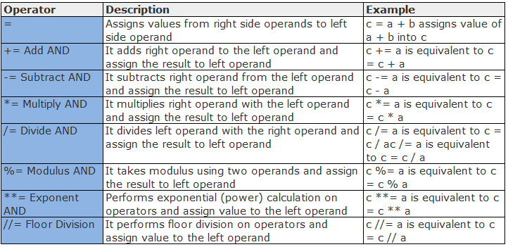
Decision Making Statement

Slide 28
If Statement
The IF statement allows you to conditionally execute a block of code.
The syntax of the IF statement is as follows:
if ( boolean expression):
STATEMENT
STATEMENT
The indented block of code following an if statement is executed if the boolean expression is true, otherwise it is skipped.

Slide 29
IF/ELSE
If you have two mutually exclusive choices, and want to guarantee that only one of them is executed, you can use an IF/ELSE statement. The ELSE statement adds a second block of code that is executed if the Boolean expression is false.
if ( Boolean expression ):
STATEMENT
STATEMENT
else:
STATEMENT
STATEMENT

Slide 30
IF/ELIF/ELSE
If you have several mutually exclusive choices, and want to guarantee that only one of them is executed, you can use an IF/ELIF/ELSE statements. The ELIF statement adds another boolean expression test and another block of code that is executed if the boolean expression is true.
if ( boolean expression ):
STATEMENT
STATEMENT
elif (2nd boolean expression ):
STATEMENT
STATEMENT
else:
STATEMENT
STATEMENT

Slide 31
While loop
The while loop repeats a block of code until a boolean expression is no longer true. Syntax:
while (boolean expression) :
STATEMENT
STATEMENT
STATEMENT

Slide 32
How to STOP looping!
It is very easy to loop forever:
while ( True) :
print “again, and again, and again”
The hard part is to stop the loop! Two ways to do that is by using a loop counter, or a termination test.
A loop counter is a variable that keeps track of how many times you have gone through the loop, and the boolean expression is designed to stop the loop when a specific number of times have gone bye.
A termination test checks for a specific condition, and when it happens, ends the loop. (But does not guarantee that the loop will end.)

Slide 33
For loop
Executes a sequence of statements multiple times and abbreviates the code that manages the loop variable.
Given the following list
>>> linguists = [“Amanda”, “Claire”, “Holly”, “Luis”, “Nick”, “Sophia”]
How do I print each name on a separate line?
>>> print linguists[0] + ‘\n’
>>> print linguists[1] + ‘\n’
>>> print linguists[2] + ‘\n’
>>> print linguists[3] + ‘\n’
>>> print linguists[4] + ‘\n’
>>> print linguists[5] + ‘\n

Slide 34
For loop
A for-loop steps through each of the items in a list, tuple, string, or any other type of object which the language considers an “iterator.”
For <item> in <collection> :
<statements>
When <collection> is a list or a tuple, then the loop steps through each element of the container.
When <collection> is a string, then the loop steps through each character of the string.
For someChar in “Hello World”:
print someChar

Slide 35
For loop
The <item> part of the for loop can also be more complex than a single variable name.
When the elements of a container <collections> are also containers, then the <item> part of the for loop can match the structure of the elements.
This multiple assignment can make it easier to access the individual parts of each element.
for (x, y) in [(‘a’,1), (‘b’,2), (‘c’,3), (‘d’,4)]:
print x

Slide 36
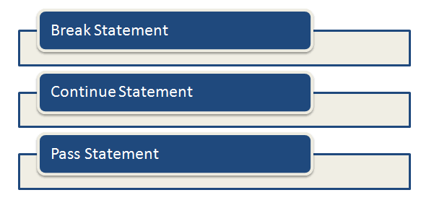
Loop Control Statements

Slide 37
FUNCTIONS
In Python a function is some reusable code that takes arguments(s) as input does some computation and then returns a result or results
We deﬁne a function using the def reserved word.
We call/invoke the function by using the function name, parenthesis and arguments in an expression.

Slide 38
Building our Own Functions
We create a new function using the def keyword followed by optional parameters in parenthesis.
We indent the body of the function.
This deﬁnes the function but does not execute the body of the function.
def print_new():
print "I'm a Python."
print ‘How can I help you?'

Slide 39
Building our Own Functions
def addtwo(a, b):
added = a + b
return added
x = addtwo(3, 5)
print x
def greet():
return “Hello”
print greet(), “Glenn”
print greet(), “Sally”
OUTPUT:
Hello Glenn
Hello Sall

Slide 40
Scope of Variables
Global variables :
Variables that are defined outside have a global scope.
Local variables :
Variables that are defined inside a function body have a local scope.
This means that local variables can be accessed only inside the function in which they are declared, whereas global variables can be accessed throughout the program body by all functions. When you call a function, the variables declared inside it are brought into scope.

